Slide 1


Department of Electronics and Communication Engineering
Deep learning based Smart glasses for women safety
Sl.no | Team Members | USN
1 | Sakshi Bagewadi | 02FE21BEC080
2 | Samruddhi V S | 02FE21BEC083
3 | Srushti pattanshetti | 02FE21BEC100
4 | Ujwala V T | 02FE21BEC105
Under the Guidance of
Prof. S. M. Hunagund

Slide 2
CONTENTS
SI.NO | TITLE
1 | Need statement
2 | Problem statement
3 | Objective
4 | Block diagram
5 | Result
6 | Plan and need for optimization
7 | Conclusion

Slide 3
Need statement
Women face safety concerns in public and private spaces, often unable to activate emergency responses manually. A hands-free, AI-powered smart glasses system is needed to detect threats, recognize distress, and trigger alerts in real time, ensuring proactive and reliable protection.

Slide 4
Problem statement
Women’s safety remains a major concern, especially in isolated areas and at night. Existing solutions require manual activation, which may not be possible in emergencies. They lack real-time threat detection, evidence collection, and work poorly without the internet. A hands-free, AI-powered smart glasses system can detect danger, record evidence, and trigger alerts automatically. This ensures faster response and enhanced security for women.

Slide 5
Introduction
To develop smart glasses that utilize deep learning for real-time detection of unsafe situations, triggering automatic buzzer alerts to ensure immediate response and deterrence.
To integrate GPS-based location tracking that transmits the user’s coordinates during emergencies, aiding quick assistance and improving safety outcomes.
To create an efficient, wearable, and power-optimized system that supports women’s safety through intelligent surveillance and rapid alert mechanisms.

Slide 6
Objectives
Monitor surroundings via camera and sensors.
Instantly alert the user and emergency contacts.
Enable GPS-based location tracking and sharing.
Integrate hardware and AI software seamlessly.
Ensure secure access through user authentication.

Slide 7
Block diagram with hardware specifications
Input
Raspberry Pi 5
Pi Camera
(Real-time feed)
YOLOv8/ML Model (Object & Person
detection)
GPS module
Emergency SMS
output
SOS Button

Slide 8
Block diagram with all software specifications
YOLOv5/YOLOv8 Model
Image Capture (OpenCV)
Real-Time Object Detection
Threat Analysis (Custom AI)
Location
GPS Module

Slide 9
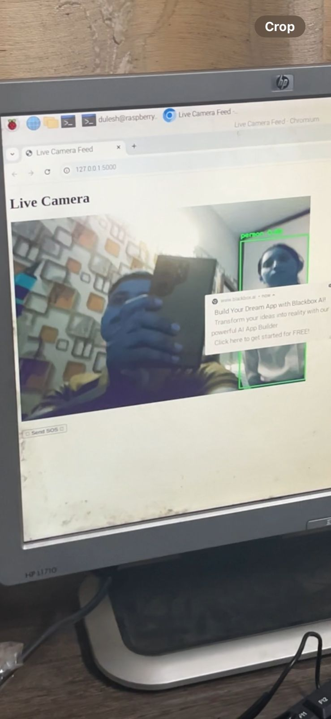
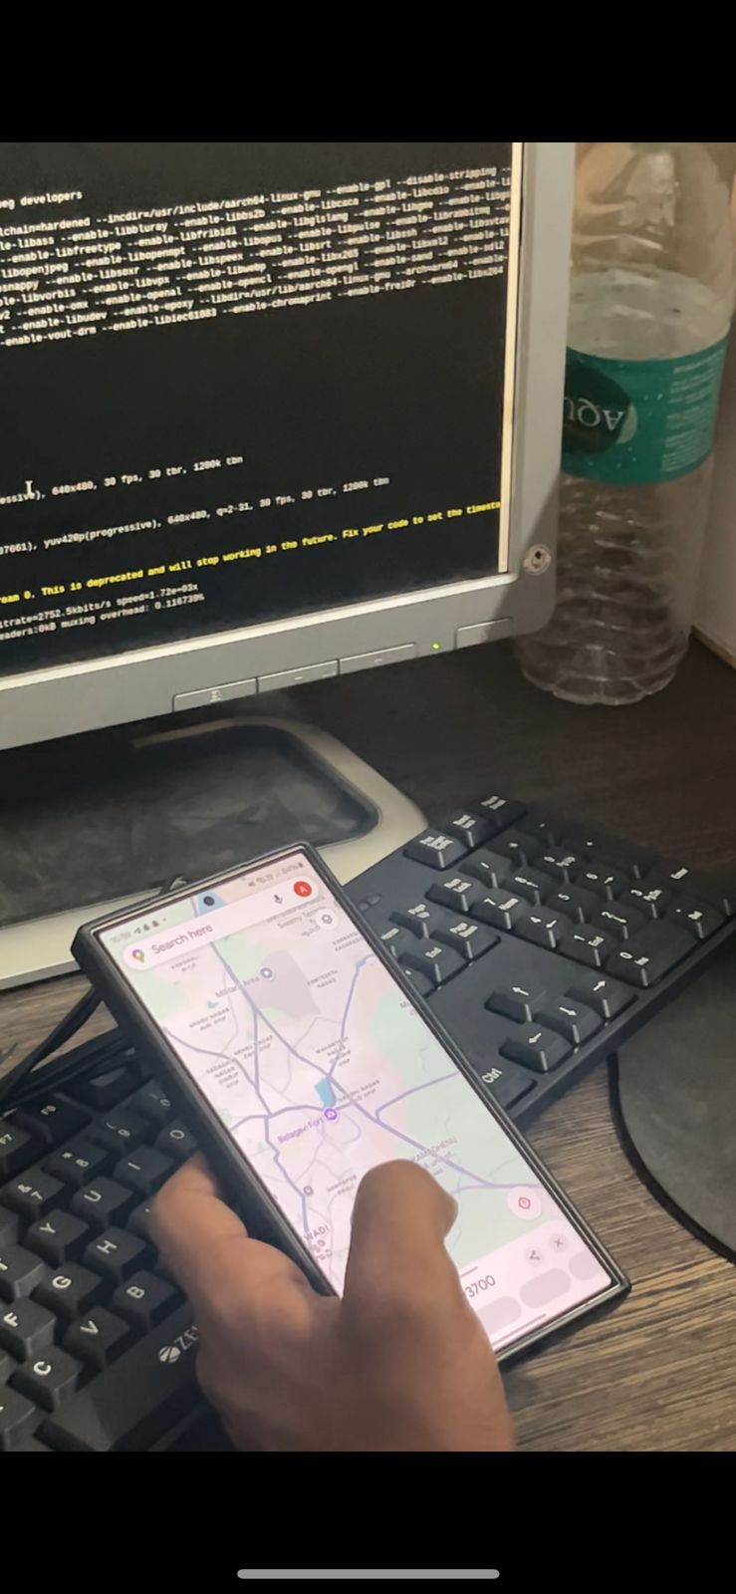
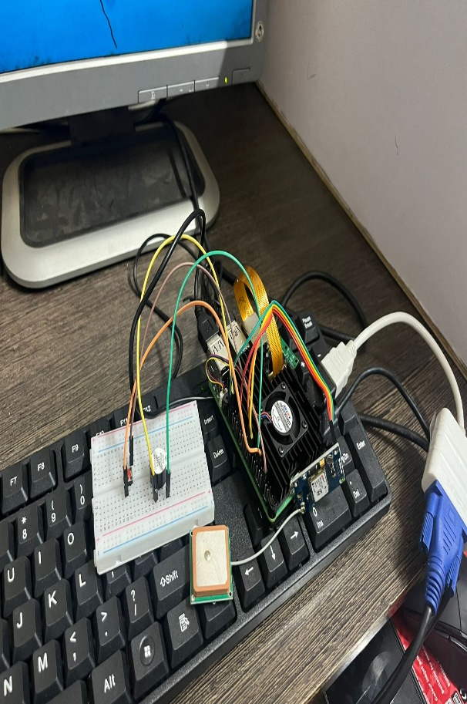
Result

Slide 10
Plan for optimization
Add GSM Module (SIM800L)
For independent SMS alerts when Bluetooth is out of range or smartphone is unavailable.
Enables offline emergency communication.
Can send predefined emergency messages with GPS coordinates
Dual Communication Support
Use Bluetooth primarily for short-range communication (to paired smartphone).
Fall back on GSM for long-range, remote emergency alerts.

Slide 11
Conclusion
AI-powered smart glasses can enhance women's safety with real-time threat detection and automated alerts. However, challenges like sensor failures, false positives, and security risks must be addressed. With improved reliability and security, this technology can provide effective and proactive protection.

Slide 12
Thank you

